Slide 1
IPython (Interactive Python)

Slide 2
🔰 Introduction
IPython (Interactive Python) is an advanced interactive shell designed to improve the standard Python programming experience.
👉 It allows:
Writing and executing Python code interactively
Real-time testing and debugging
Rich output like graphs, tables, and images
💡 Key Idea:
Instead of writing full programs and running them, IPython lets you experiment line-by-line.
IPython makes Python more powerful, interactive, and user-friendly, especially for developers and data scientists.”

Slide 3
Need for IPython
Problems with Standard Python Shell:
No syntax highlighting
No auto-complete
Difficult debugging
No visualization support

Slide 4
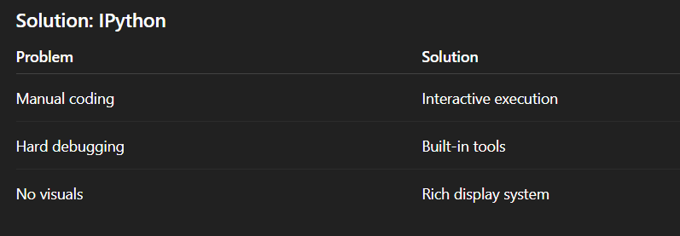

Slide 5
Core Features of IPython
4.1 Interactive Execution
Execute code line-by-line
Immediate feedback
x = 5
x * 2
Output appears instantly → Faster testing

Slide 6
Auto-completion
Press Tab to complete:
import math
math.sq # press TAB → sqrt
✔ Saves time
✔ Reduces errors

Slide 7
Syntax Highlighting
Keywords, variables, functions are colored
Improves readability and debugging

Slide 8
Magic Commands (🔥 Important)
%timeit sum(range(1000))
%pwd
%who
Explanation:
%timeit → measures execution time
%pwd → current directory
%who → shows variables

Slide 9
Cell Magic Commands (%%)
%%time
sum(range(1000000))
Runs entire cell as one block

Slide 10
Object Introspection
Use ? or ??
len?
Shows:
Function definition
Parameters
Documentation

Slide 11
History Management
History
Stores previously executed commands
Helps in revisiting past code

Slide 12
Debugging Support
%debug
Step-by-step error tracking

Slide 13
Rich Output Display
IPython can display:
Images
Graphs
Tables
HTML
from IPython.display import Image
Image("sample.png")

Slide 14
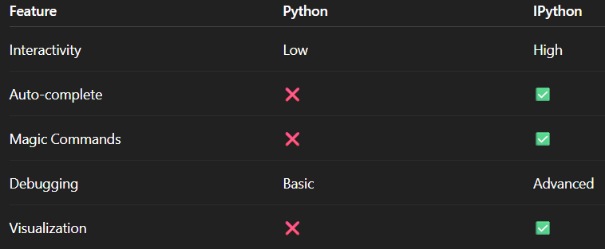
📊 IPython vs Python Shell

Slide 15
IPython and Jupyter
IPython is the execution engine
Jupyter Notebook provides the GUI
Architecture:
User → Jupyter Notebook → IPython Kernel → Python Execution

Slide 16
Installation & Setup
Install:
pip install ipython
Run:
ipython
For Jupyter:
pip install notebook
jupyter notebook

Slide 17
Live Demo (VERY IMPORTANT)
# Step 1: Variables
a = 10
b = 20
a + b
# Step 2: Magic command
%timeit sum(range(1000))
# Step 3: Help
print?
# Step 4: Auto-complete demo
import math
math.sqrt(25)

Slide 18
Applications of IPython
Data Science
Machine Learning
Scientific Research
Education
Rapid Prototyping

Slide 19
Advantages
Interactive coding
Easy debugging
Fast experimentation
Supports visualization
Beginner-friendly

Slide 20
Limitations
High memory usage
Requires understanding of commands

Slide 21
Conclusion
IPython enhances Python with interactivity
Essential for modern computing tasks
Foundation of Jupyter ecosystem
Improves productivity and learning

